Slide 1



Welcome to Azure Bootcamp!!!
Abdul Rasheed Feroz Khan
Twitter - @TechFero | @CodeSizzler
Notes:
Add your pic, contact info and bio

Slide 2
Getting Started with your Subscription
Lab guides for this course are on available on the same repository.
Each lab in this course will be accessed from the Azure Portal.
You will have access until next 30 days from the date of activation.
DEMO ! Login ! Learn Learn Learn!
Notes:
Speaking points
Login to www.opsgility.com
Find one of the lab guides in this course – click the beaker icon on the left to show how to open the guide.
There are buttons to show full screen in the lab or to open in a different window.. Show them
Click on Learning Solutions -> All Courses – change the filter by to Online to show all of the other available online courses
Filter by labs to show the other labs available

Slide 3
Agenda
Introduction to Azure Cloud.
Azure WebApps – Deployment Slots on Azure.
Traffic Manager.
Azure Virtual Machines – VM ScaleSet | Powershell.
Storage Accounts – Blobs, Files, Tables and Queues.

Slide 4


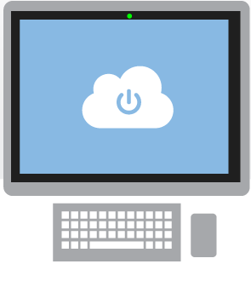
What is cloud?
The practice of using a network of remote servers hosted on the Internet to store, manage, and process data, rather than a local server or a personal computer.
An approach to computing that’s about internet scale and connecting to a variety of devices and endpoints
Notes:
I see the cloud is moving away from a Mere VM ( the virtual Machine to ) a Intelligent Cloud . May be major role is Played by PAAS ( Platform of as a Service) in the form of application like iOt SUITE, Machine learning etc.

Slide 5
Why the cloud?
Rapidly setup environments to drive business priorities
Scale to meet peak demands
Increase daily activities, efficiency and reduced cost.
Speed
Scale
Economics
Notes:
Why cloud as it takes care of Speed , scale and economics.
We have Data Center Spread across the Global to take care of Low latency i.e speed and there are more way and means to achieve this. Well I love the concept of Scale here which is so meaning full and offcourse at the end of the day its scale of economics.

Slide 6

What is Microsoft Azure?
Azure is Microsoft’s cloud computing platform, a growing collection of integrated services—analytics, computing, database, mobile, networking, storage, and web—for moving faster, achieving more, and saving money.

Slide 7
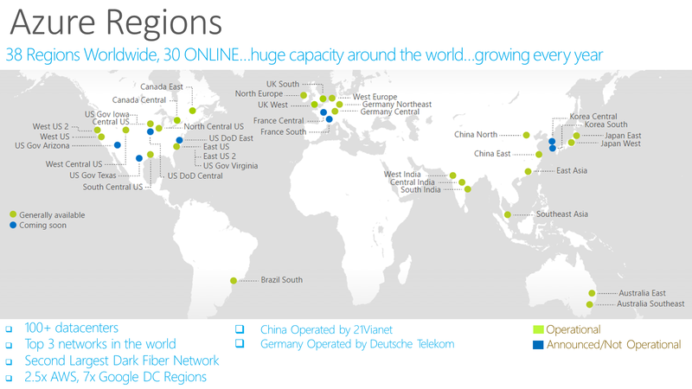
Notes:
https://azure.microsoft.com/en-us/regions/
Over the last few years we’ve truly delivered a huge infrastructure to enable us to grow our services at scale around the globe. Whether it’s our flagship facilities in Quincy, Washington or Boydton, Virginia, or some of the newly announced facilities in Shanghai, Australia and Brazil, it really is key for us to make smart investments around the world to deliver services in a resilient and reliable fashion.
A lot of people ask, what goes into site selection at Microsoft and how do we decide where to place our datacenter investments? There are over thirty-five factors in our site selection criteria. But really, the top elements are around proximity to customers and energy and fiber infrastructure, insuring that we have the capacity and the growth platforms to be able to grow our services.
Another key element is about skilled workforce. We need to insure that we have the right people to run and operate our datacenters on a day to day basis.

Slide 8
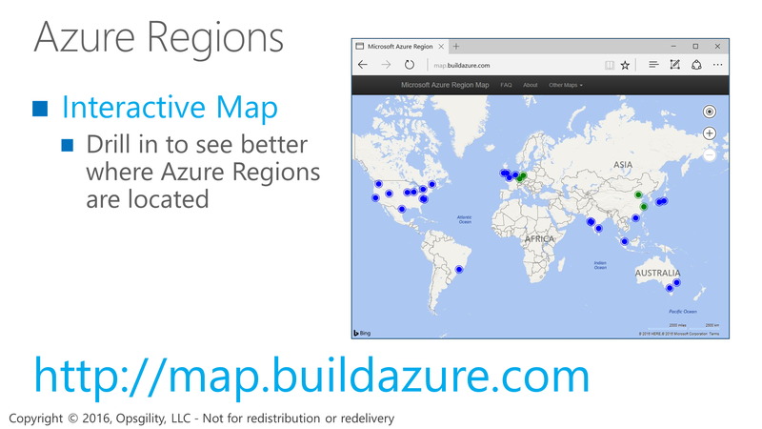
Azure Regions

Slide 9
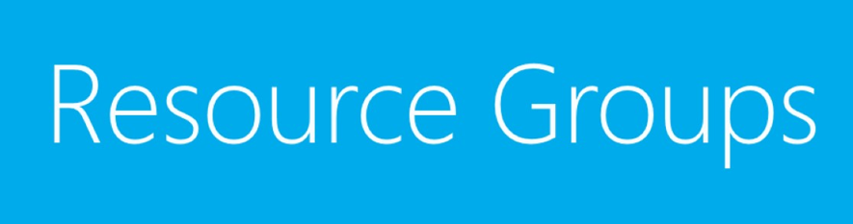
Resource Groups

Slide 10
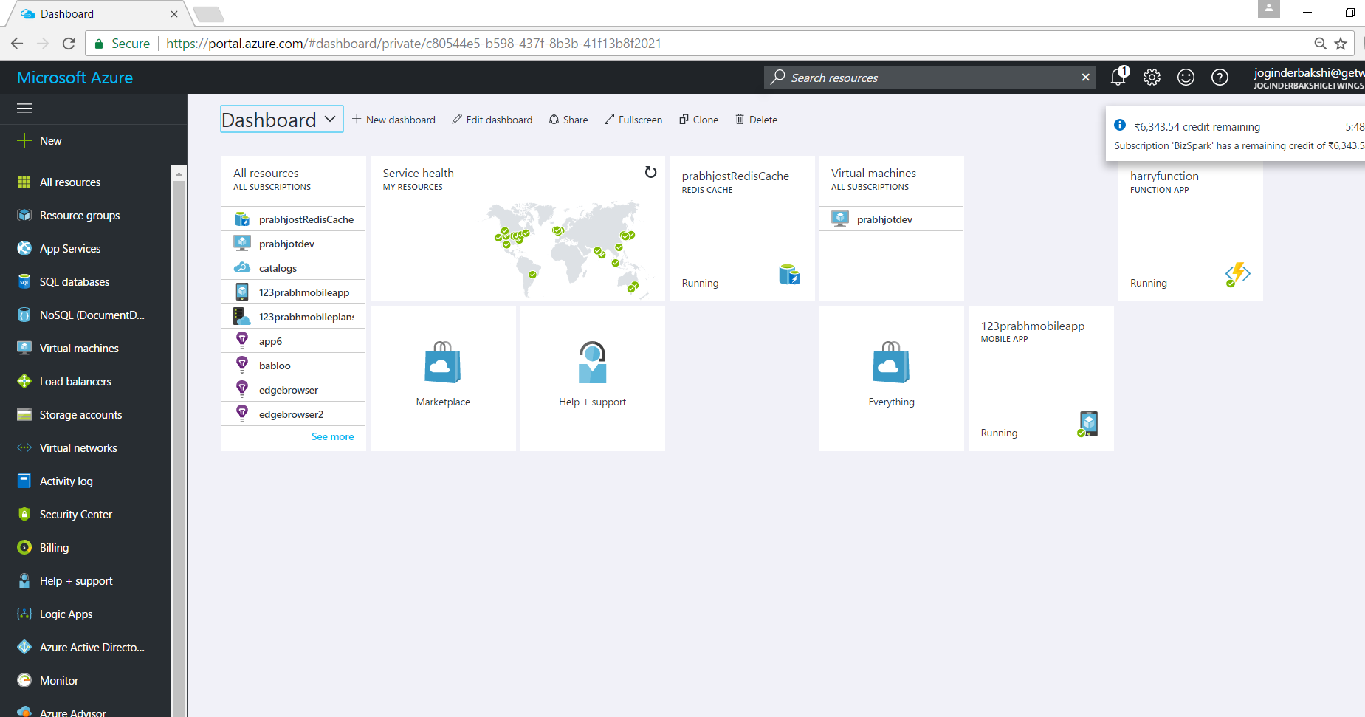
Demo – How the Azure Portal Looks likes

Slide 11
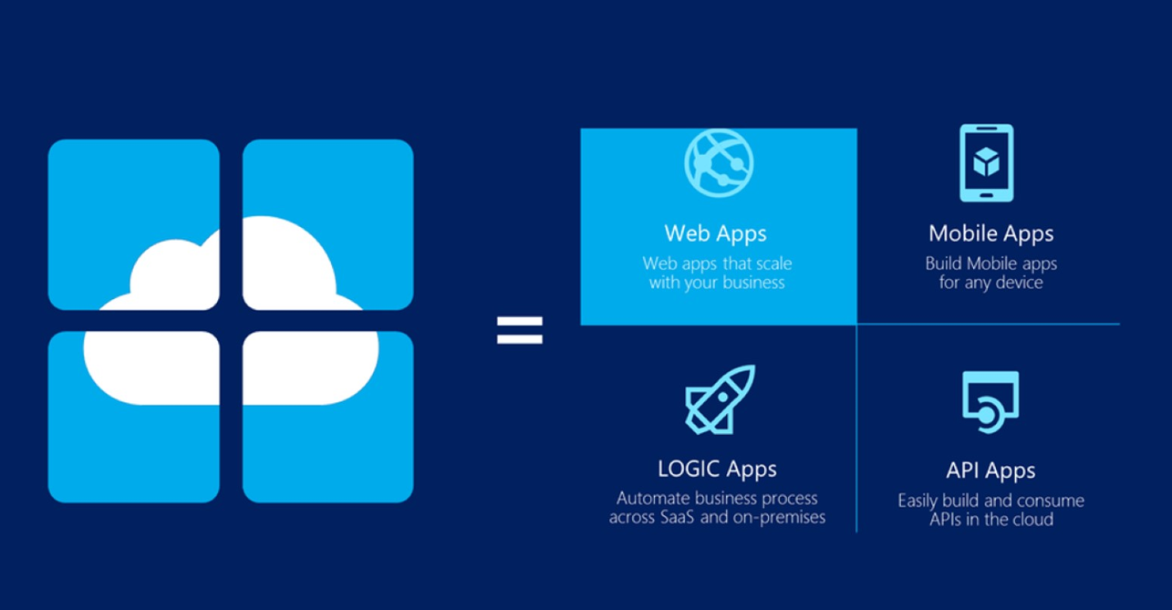

Slide 12

Azure WebApps

Slide 13
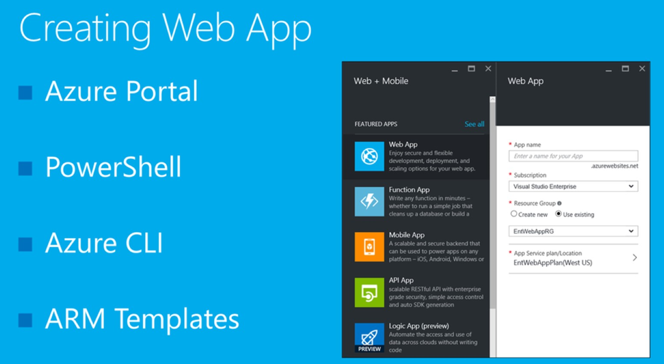

Slide 14
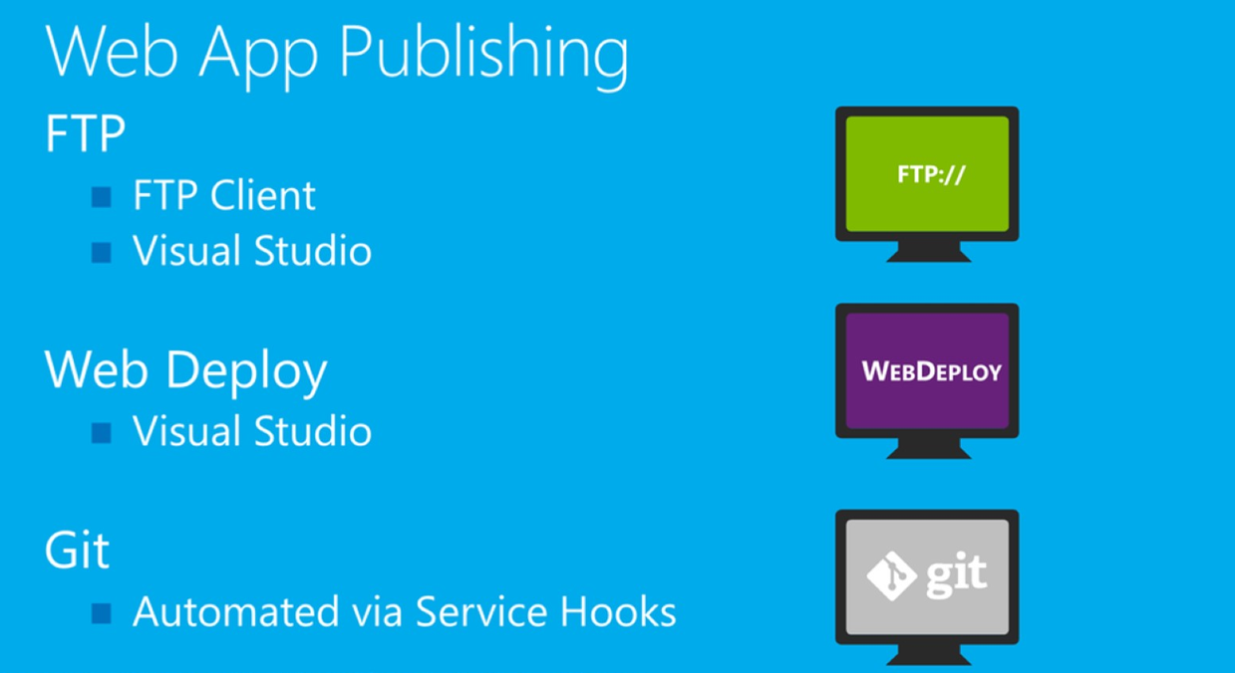

Slide 15
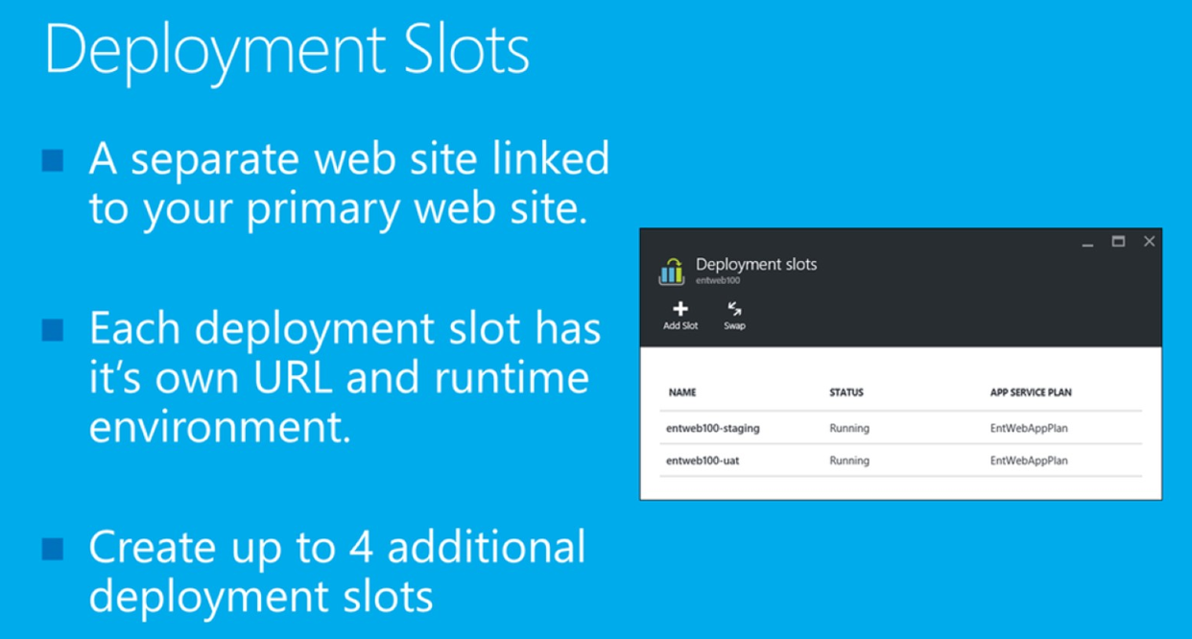

Slide 16
Demo – Azure WebApps & Traffic Manager

Slide 17
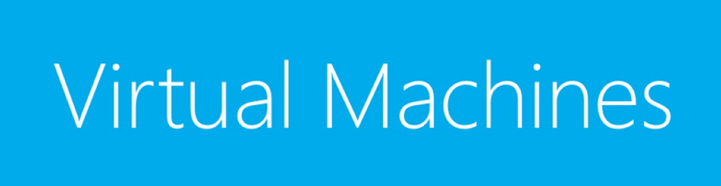

Slide 18
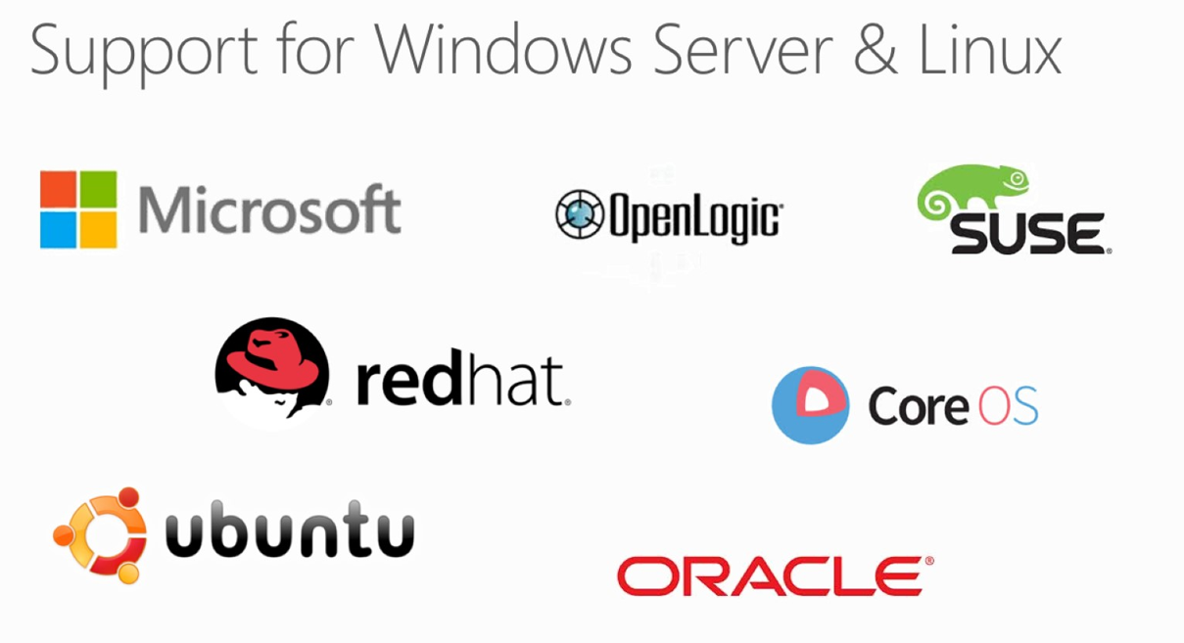

Slide 19
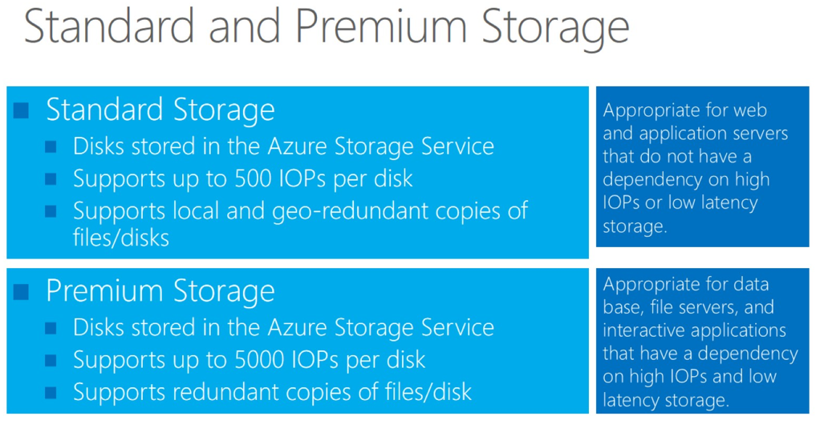

Slide 20
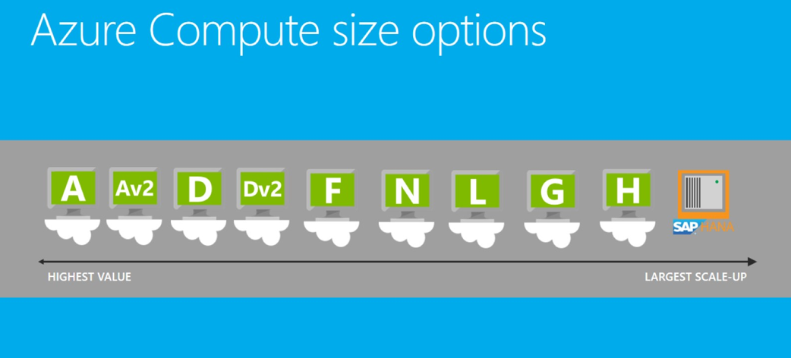

Slide 21
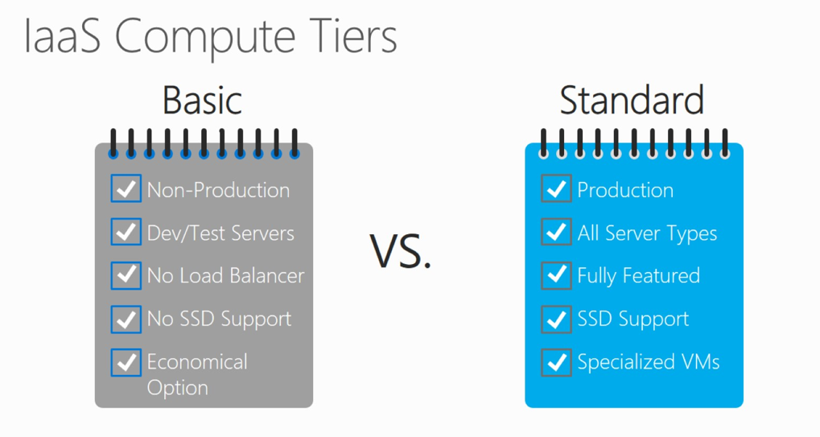

Slide 22
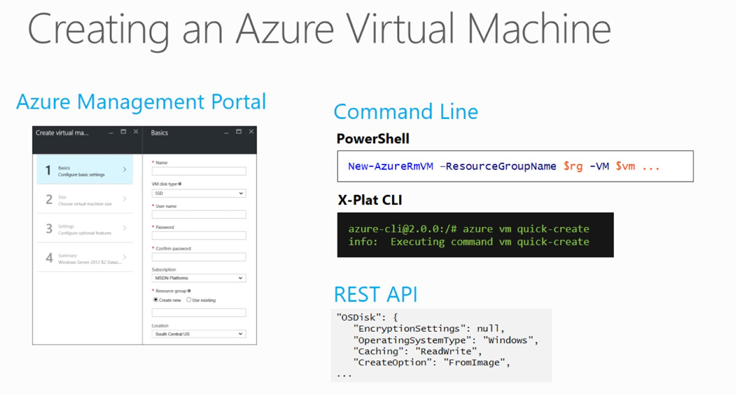

Slide 23
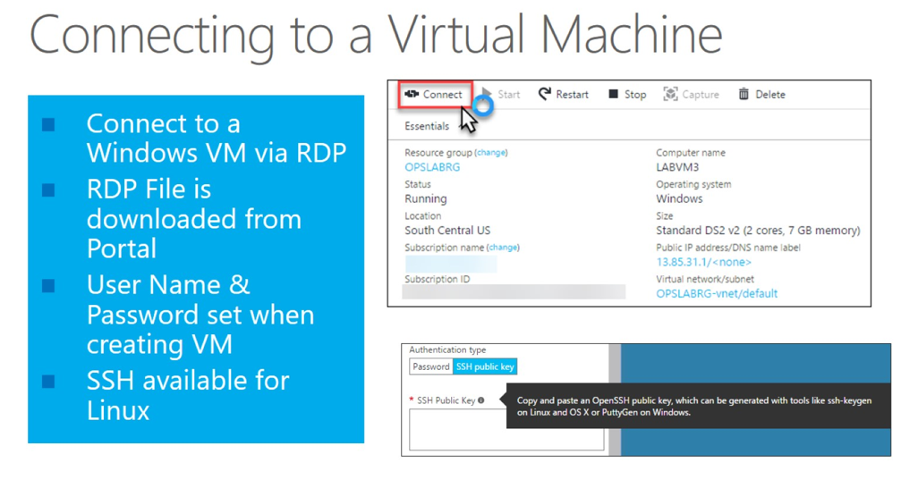

Slide 24
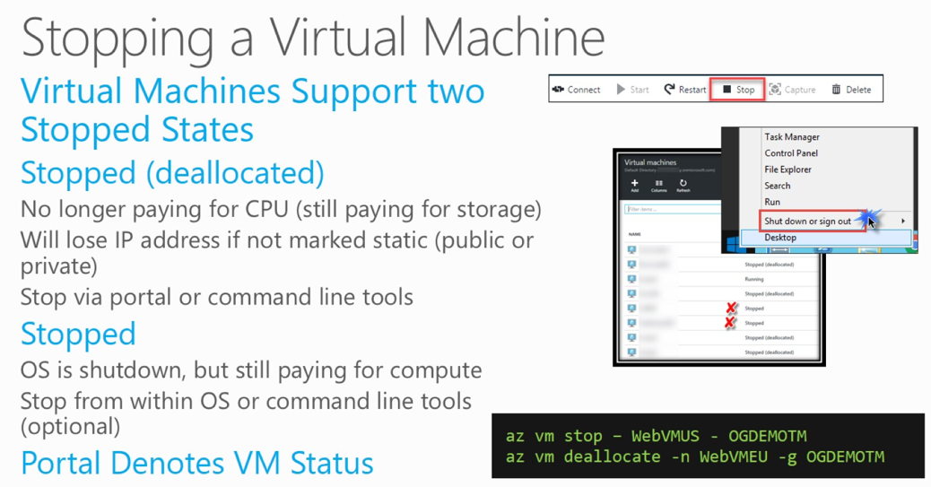

Slide 25
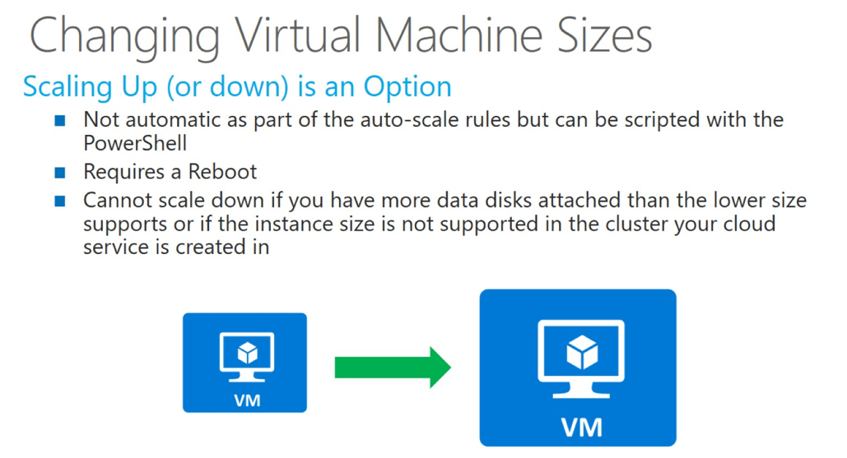

Slide 26
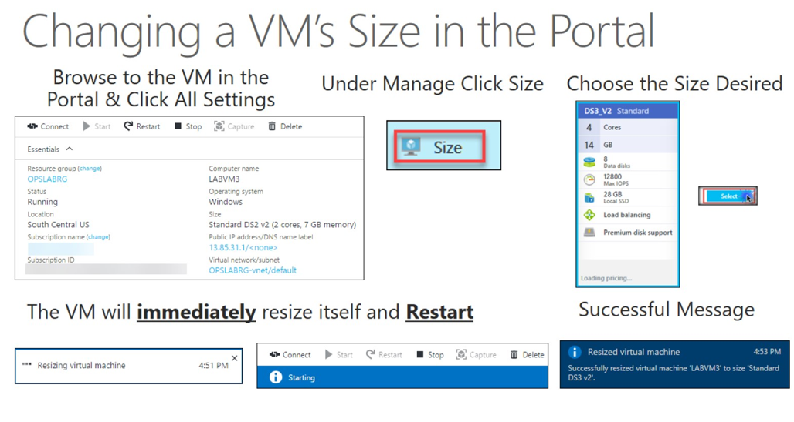

Slide 27
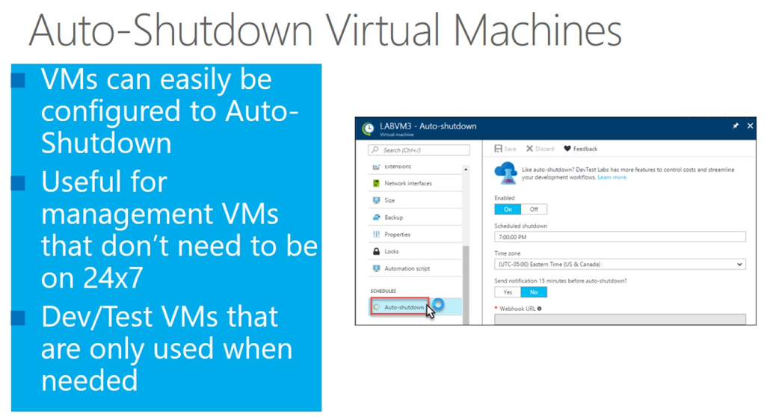

Slide 28
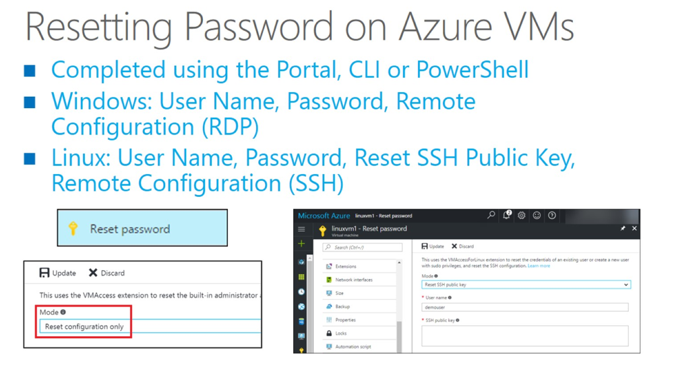

Slide 29
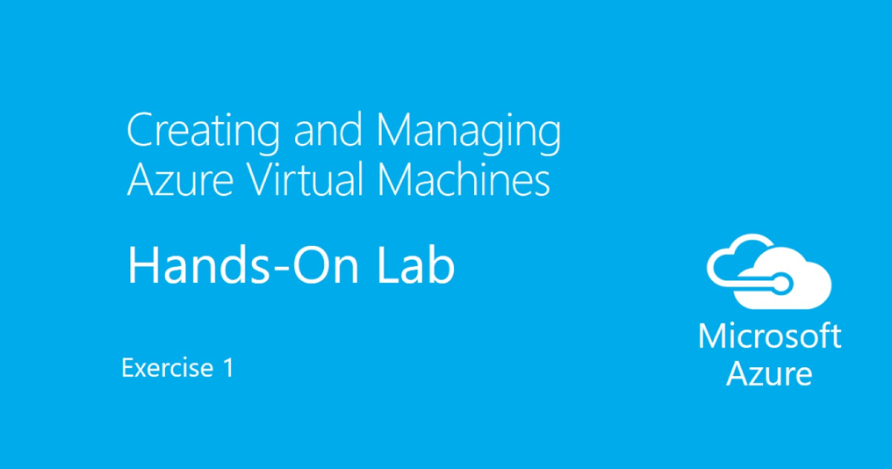

Slide 30
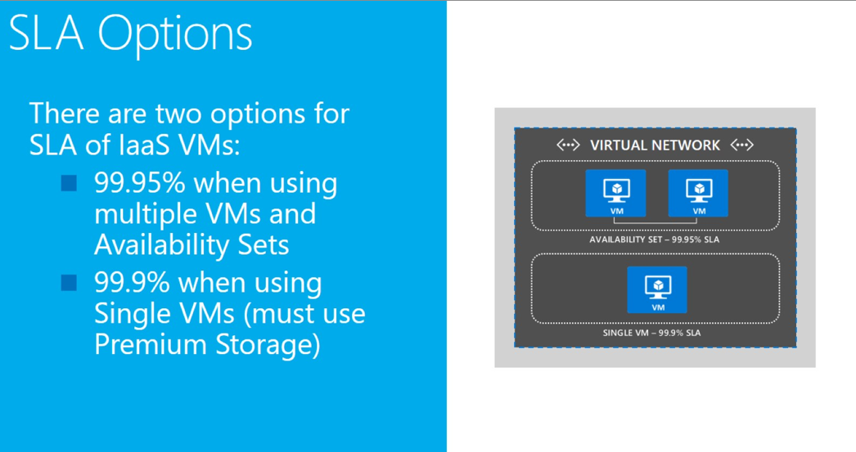

Slide 31
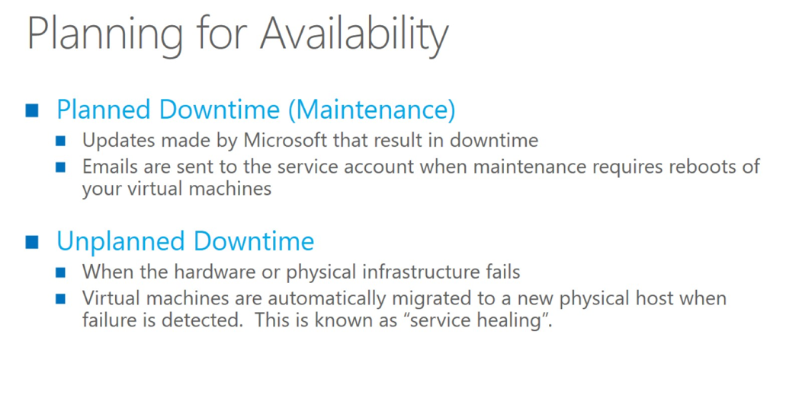

Slide 32
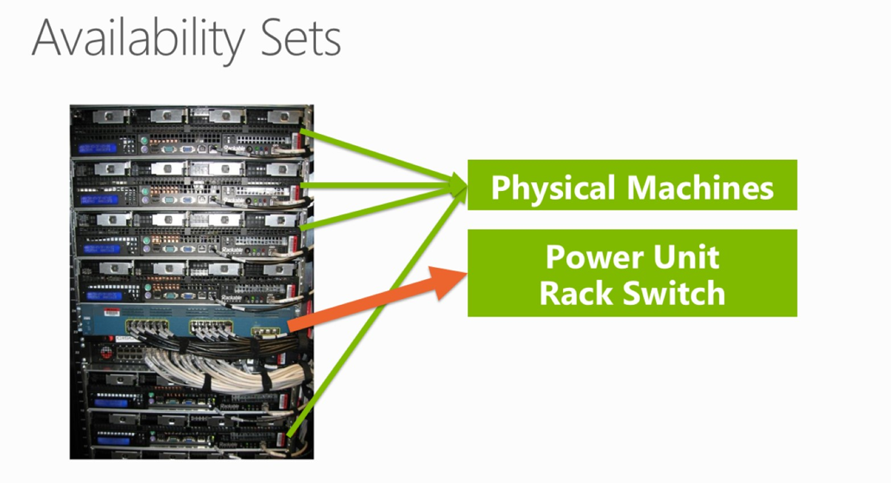

Slide 33
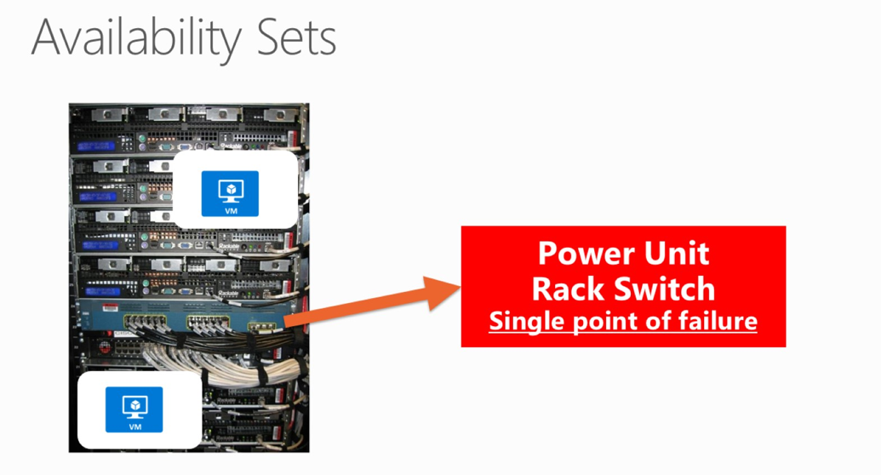

Slide 34
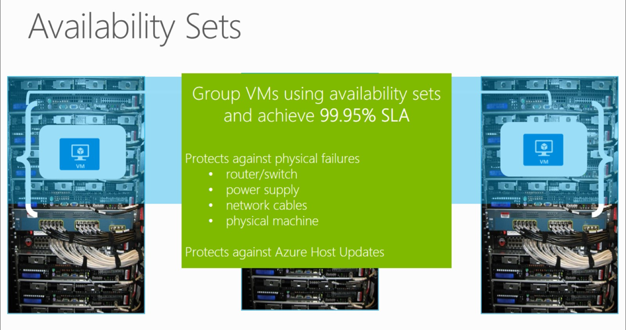

Slide 35
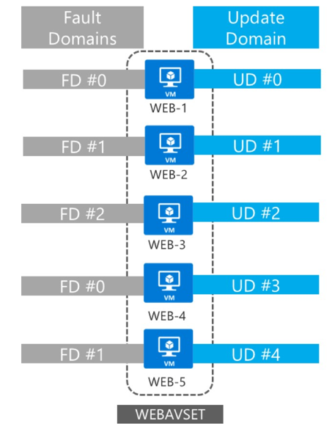

Slide 36
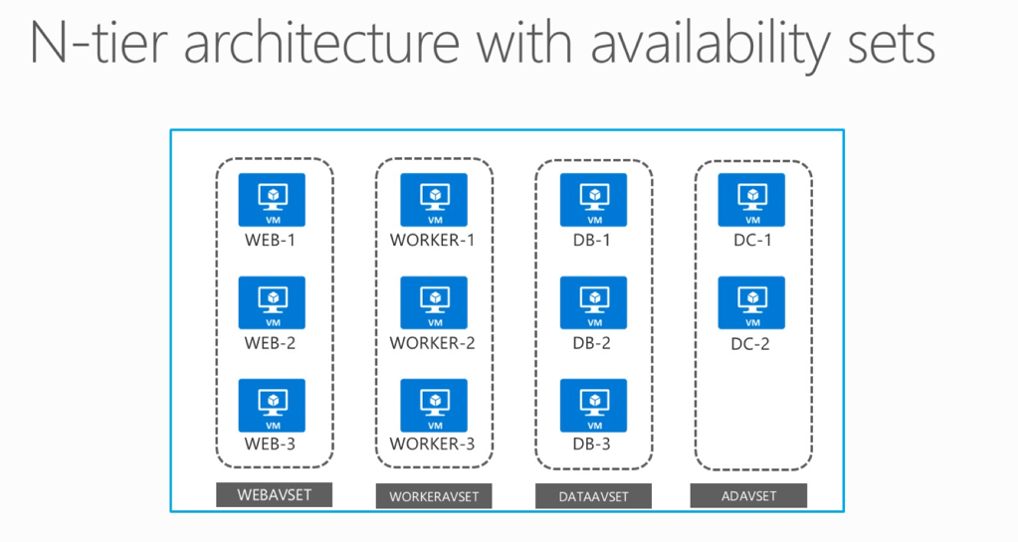

Slide 37
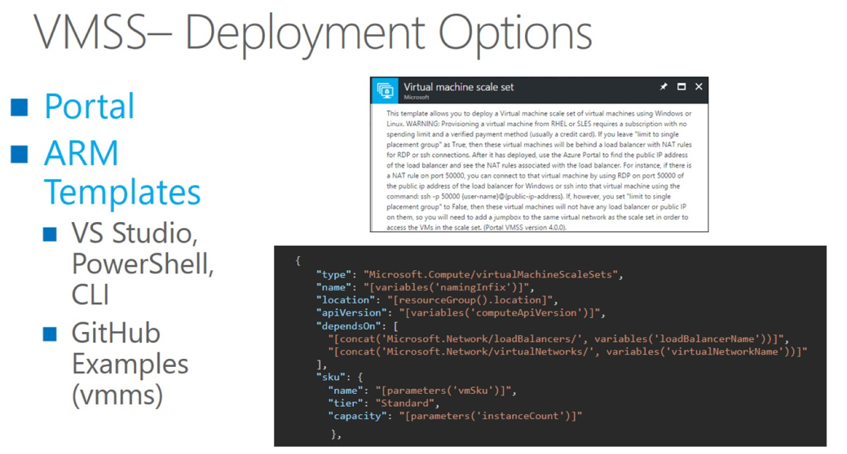

Slide 38
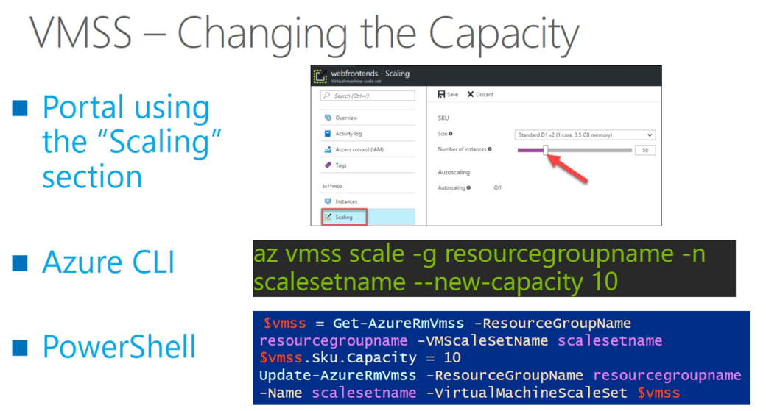

Slide 39
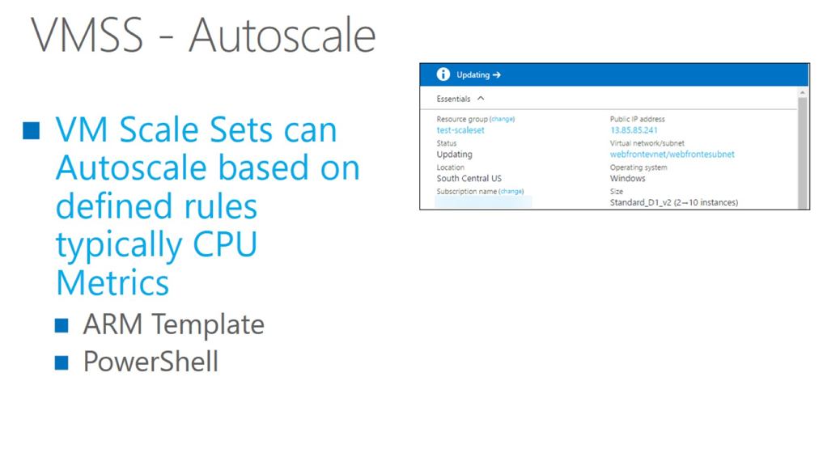

Slide 40


Slide 41
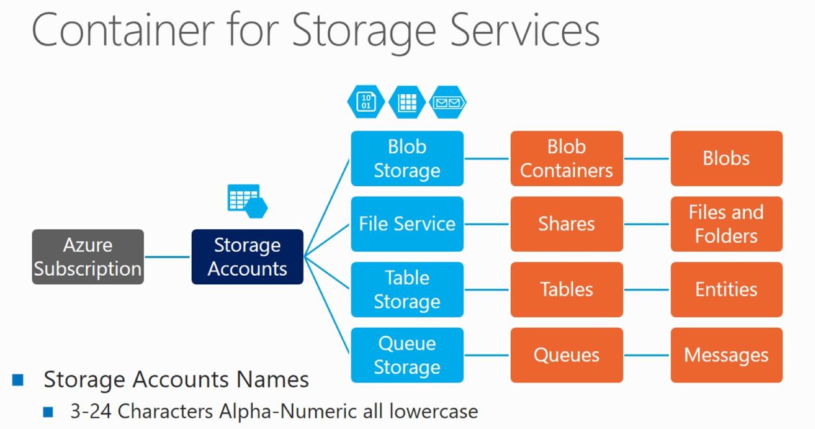

Slide 42
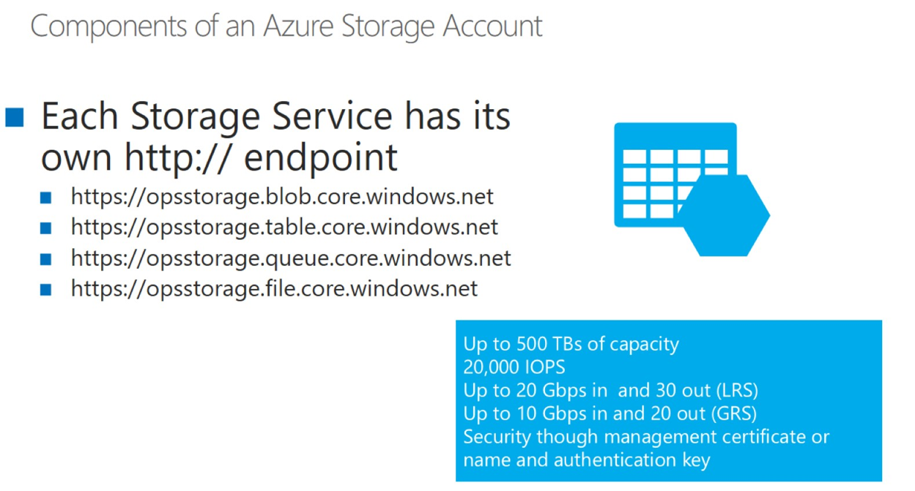

Slide 43
Thanks for Joining!!

